Slide 1
Micro credit defaulter
Problem Statement-
With the covid 19 impact in the market, we have seen lot of changes in the car market. Now some cars are in demand hence making them costly and some are not in demand hence cheaper. One of our clients works with small traders, who sell used cars. With the change in market due to covid 19 impact, our client is facing problems with their previous car price valuation machine learning models. So, they are looking for new machine learning models from new data. We have to make car price valuation model.

Slide 2
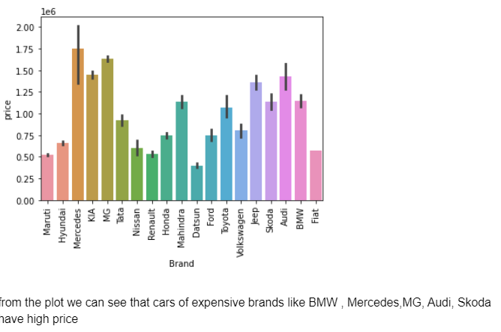
EDA

Slide 3
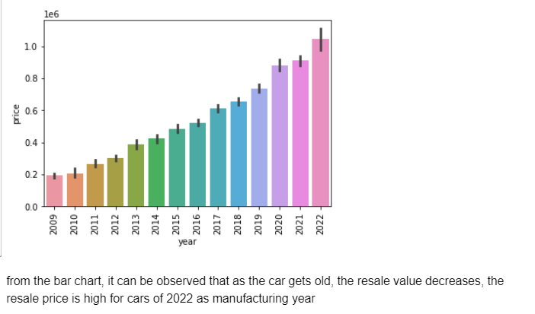
EDA

Slide 4
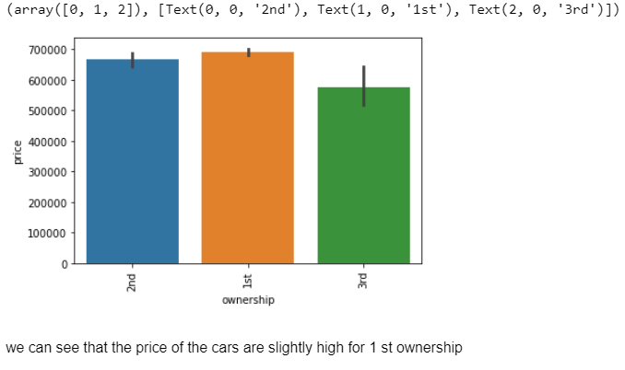
EDA

Slide 5
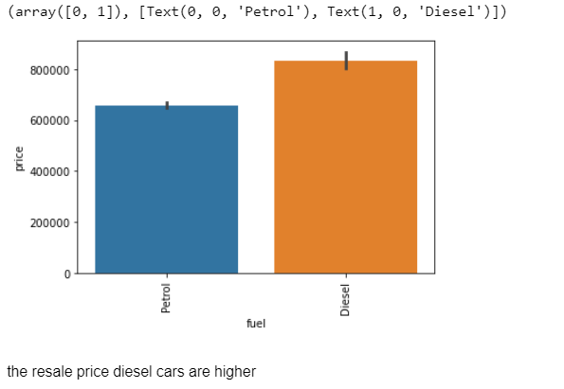
EDA

Slide 6
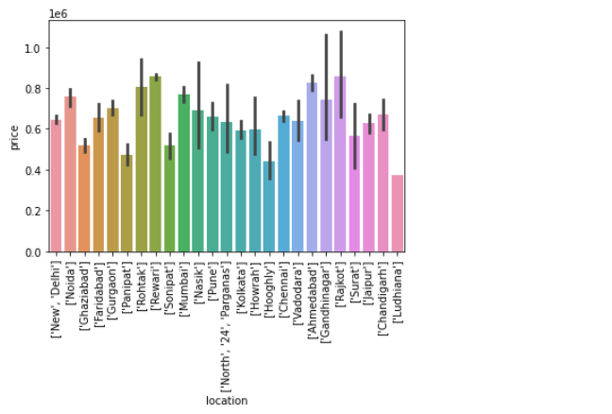
EDA

Slide 7
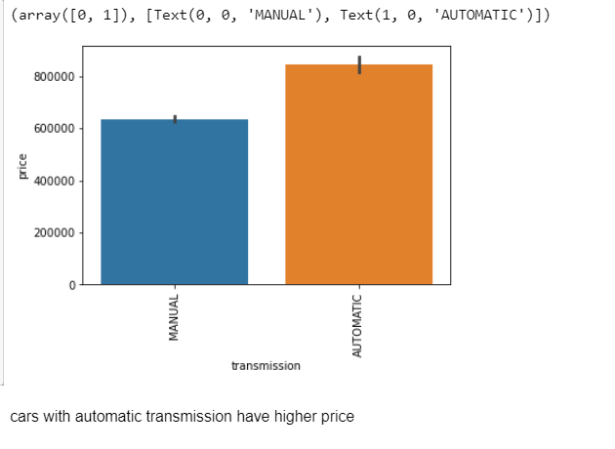
EDA

Slide 8
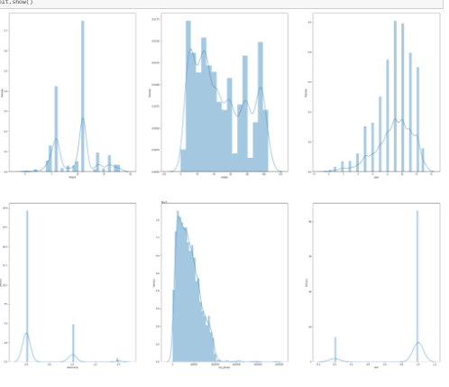
EDA

Slide 9
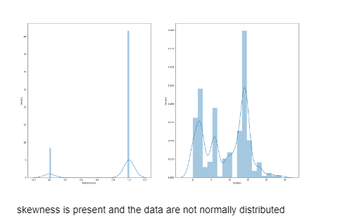
EDA

Slide 10
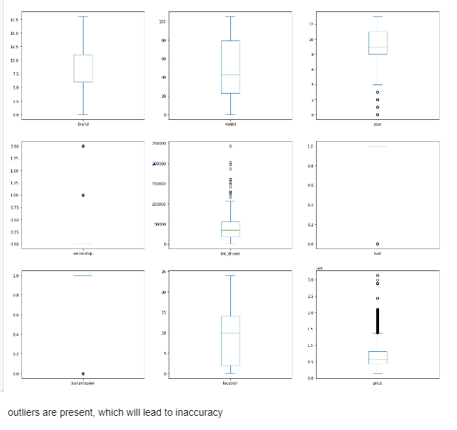
EDA

